Slide 1

Expensify
A one setp solution for manage personal expense

Slide 2
Problem Definition
As lots of expense manager applications are there in market but they only provide basic features to user in free version and advanced features are paid so to solve this Expensify is the one step towards it.
The problem behind free to use expense manager application is that they are just showing only static information of the user .
Expensify provides a very user-friendly UI by showing various expense graphs, different modes to view data and backup of data in different formats with advanced biometric security.

Slide 3
Abstract of the Project
In today’s busy and expensive life we are in a great rush to make money. But at the end of the month we broke off.
As we are unknowingly spending money on little and unwanted things. So, we have come over with the idea to track our expense.
Expensify aims to help everyone who are planning to know their expenses and save from it.

Slide 4
Features
Manage budget.
Budget exceed alert.
Manage Expense with various pre-defined categories with different payment modes.
Different modes to view transaction like today's, current week, current month and custom.
Various Graphs to analyse the expense like current week, current month and custom.
Backup of data in the form of pdf and csv.
Biometric Security.

Slide 5
Concepts used in development
SQLite
Shared Preferences
Intent
Scale Animation
Recycler View
Custom Spinner
Custom Dialog
Biometric Class
Pdf Class
Nmap Charts
Material Design
Circular Image view
Splash screen
Calendar

Slide 6
Learned during project
Database Connectivity
Data storage and Data passing
Scale Animation
Create and display recycler view with swipe controls
Date Conversion
Create custom spinner and custom dialog box
Nmap charts
Application exit alert
Material design components
Biometric Feature
Pdf class and making layout for pdf
Backup of database

Slide 7
Future Enhancement
Saving feature
Budget exceed alert notification
User defined category for expense

Slide 8
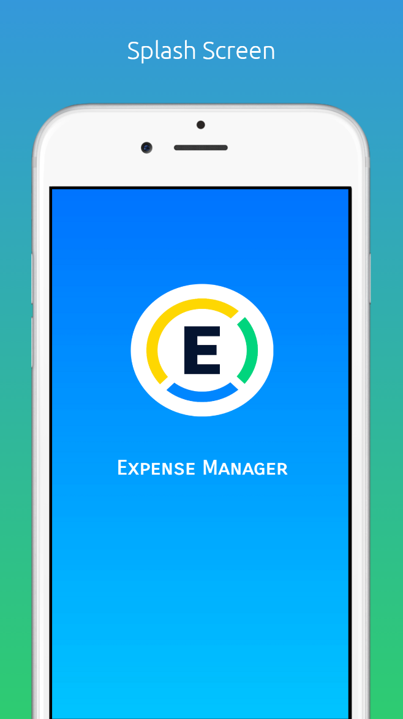
Splash screen

Slide 9
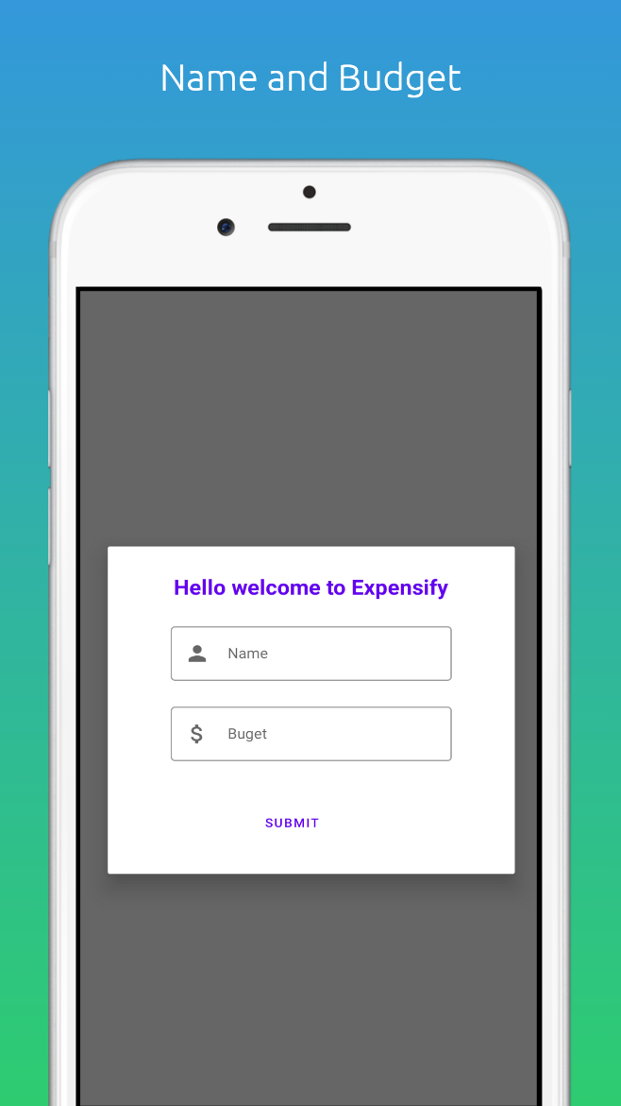
Using this Dialog box user can add Name and Budget

Slide 10
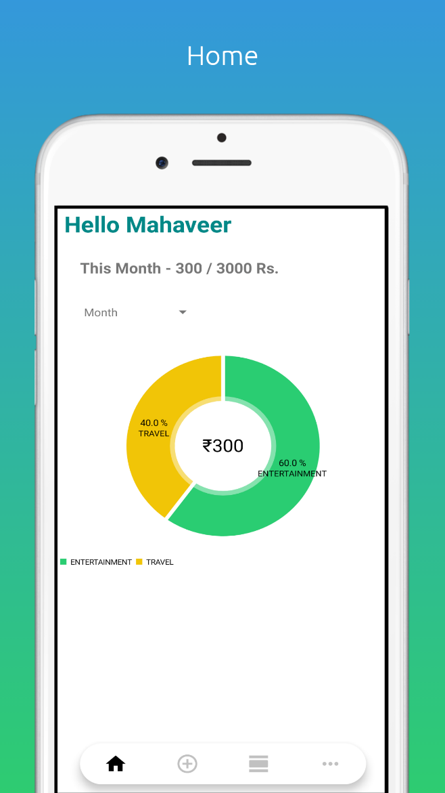
Home page display user name, budget and its utilization with pie chart in different view modes.

Slide 11
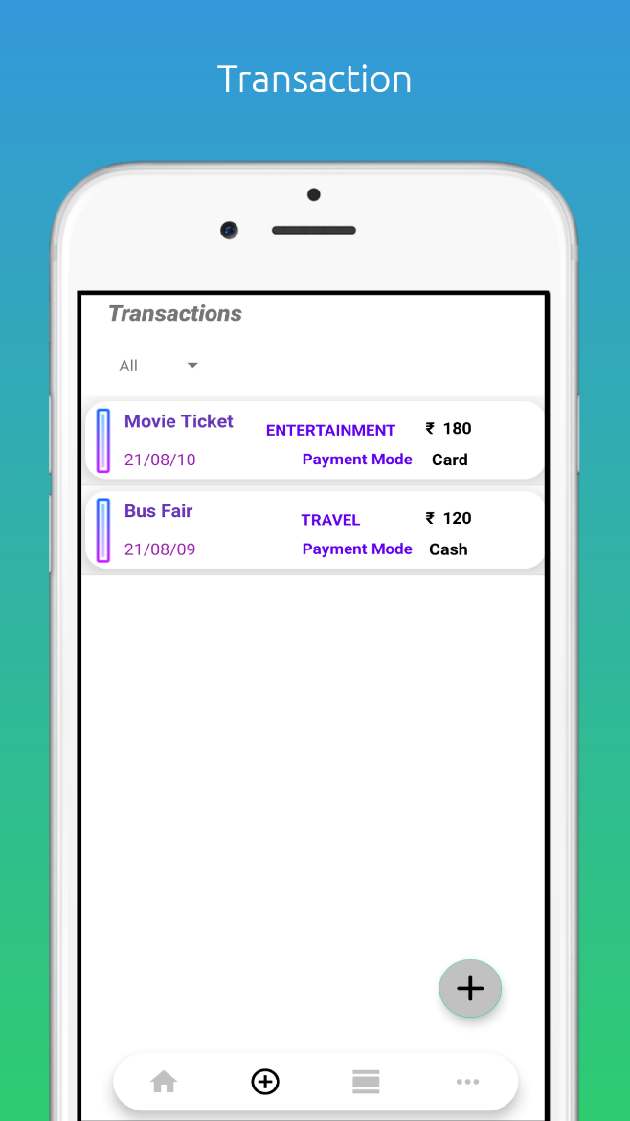
Transaction page allows user to view and manage expense in different modes with swipe action

Slide 12
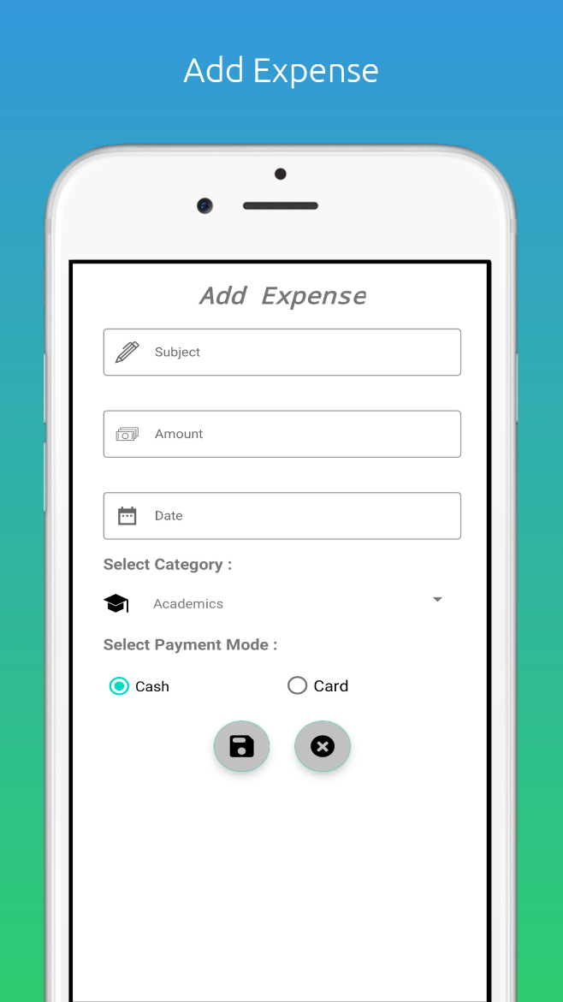
Add Expense page is used to add daily expense of the user in different categories

Slide 13
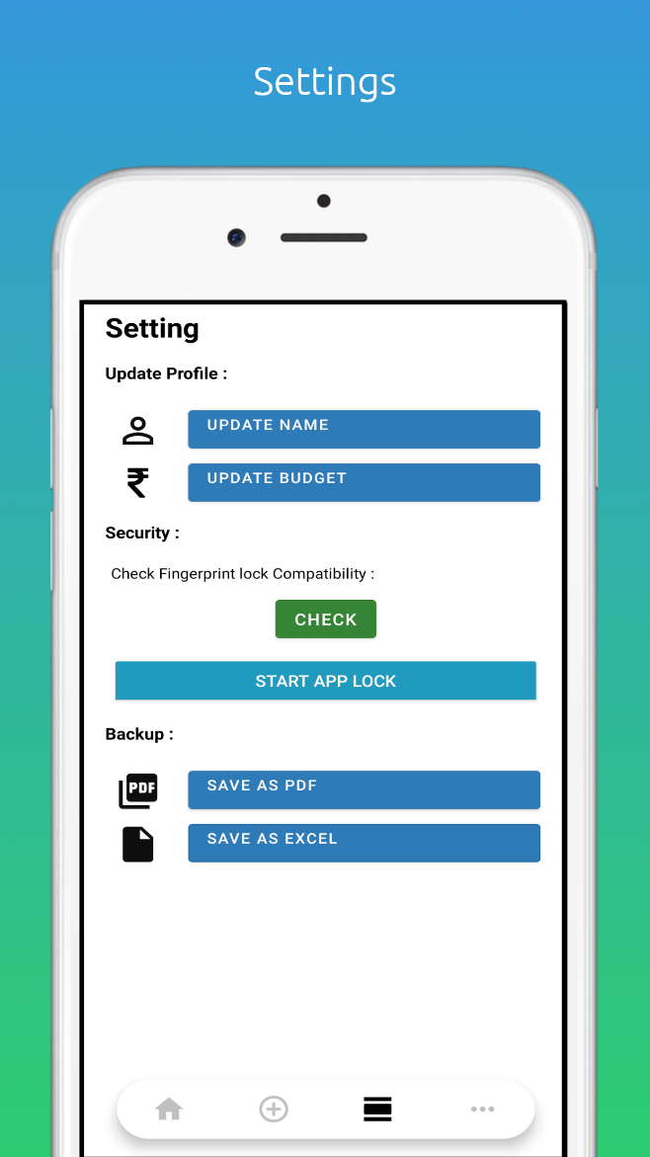
Settings page provides update profile, security and backup feature

